Slide 1
Stock Price Market Prediction
Using Python and Machine Learning Model

Slide 2
Summary
Purpose
Question
DataSource
The purpose of this project is to target the audience like traders, brokers, investors and individuals that predict stocks prices.
We have used machine learning model in neural network.
- What is the expected value of the customers' stocks based on their portfolio in the future? (prediction)
- What is the future value of the customers' stocks based on their current portfolio?
- Data is gathered from yahoo finance
-This interactive dashboad helps with Stock Price Prediction. This dashboard has been created using SP500 historical data obtained

Slide 3
Exploratory Analysis

Slide 4
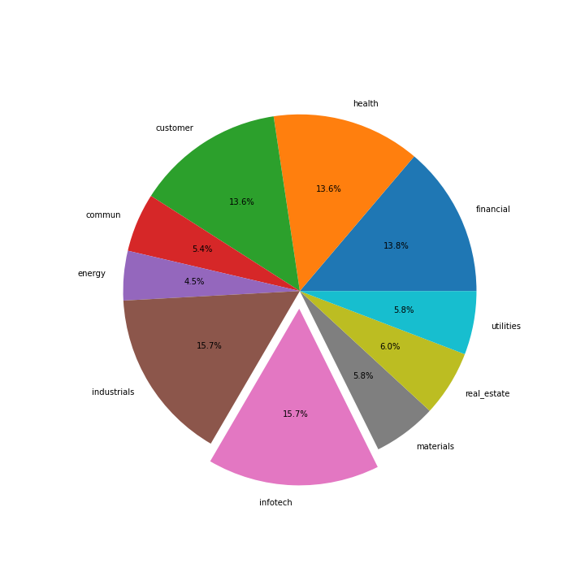
Exploratory Analysis
This pie chart is created using data retracted from Yfinance data.
The datasets includes 11 different sectors like healthcare, technology etc.
500 stocks were calculated in total.
This chart shows that which sector has highest number of stocks for instance infotech and industrial has same and highest number of stocks.

Slide 5
Implementation

Slide 6
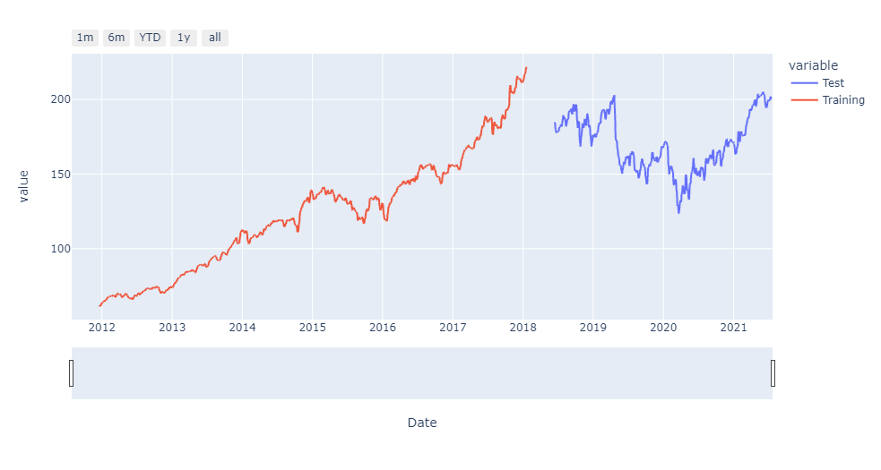
Fig 6 The image below shows for the testing vs. training data with sample data

Slide 7
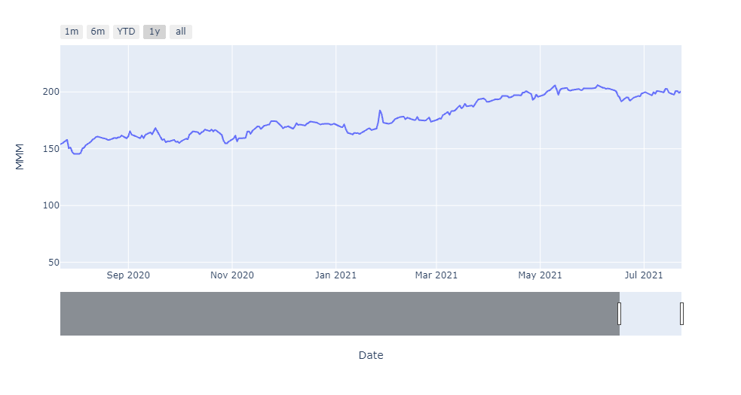
Fig 7 The image below only shows the current stock price for the 3M (MMM) stocks

Slide 8
Data Visualization

Slide 9
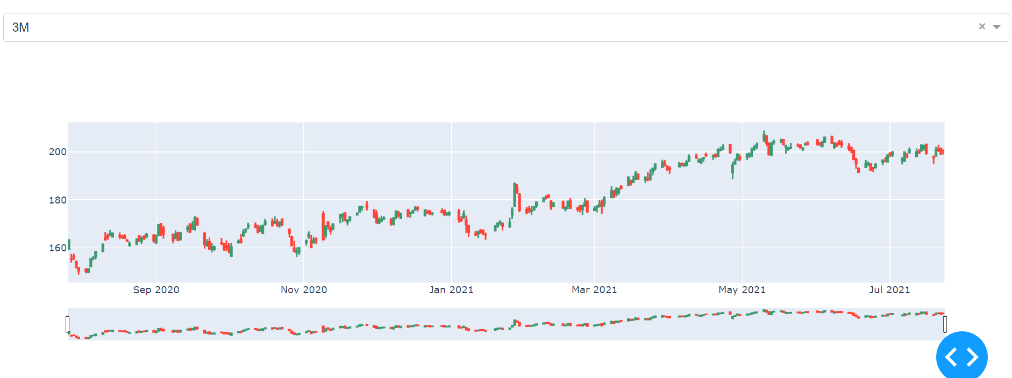
Fig 8 Below is the image of sample stock MMM that interactive dashboard created for client to predict the growth of portfolio

Slide 10
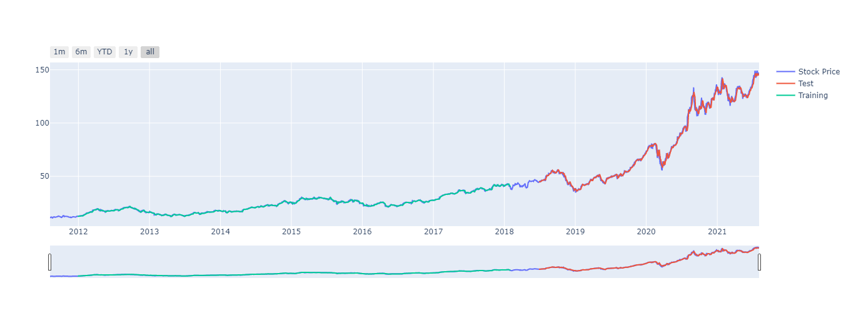
Fig 9 The image below only shows the current stock price for the 3M (MMM) stocks with training and testing data that helps us to estimate the future price of stock.

Slide 11
Dashboard
The tools we are using to make the dashboard interactive:
Dash
Plotly
Python (py)
Tools

Slide 12
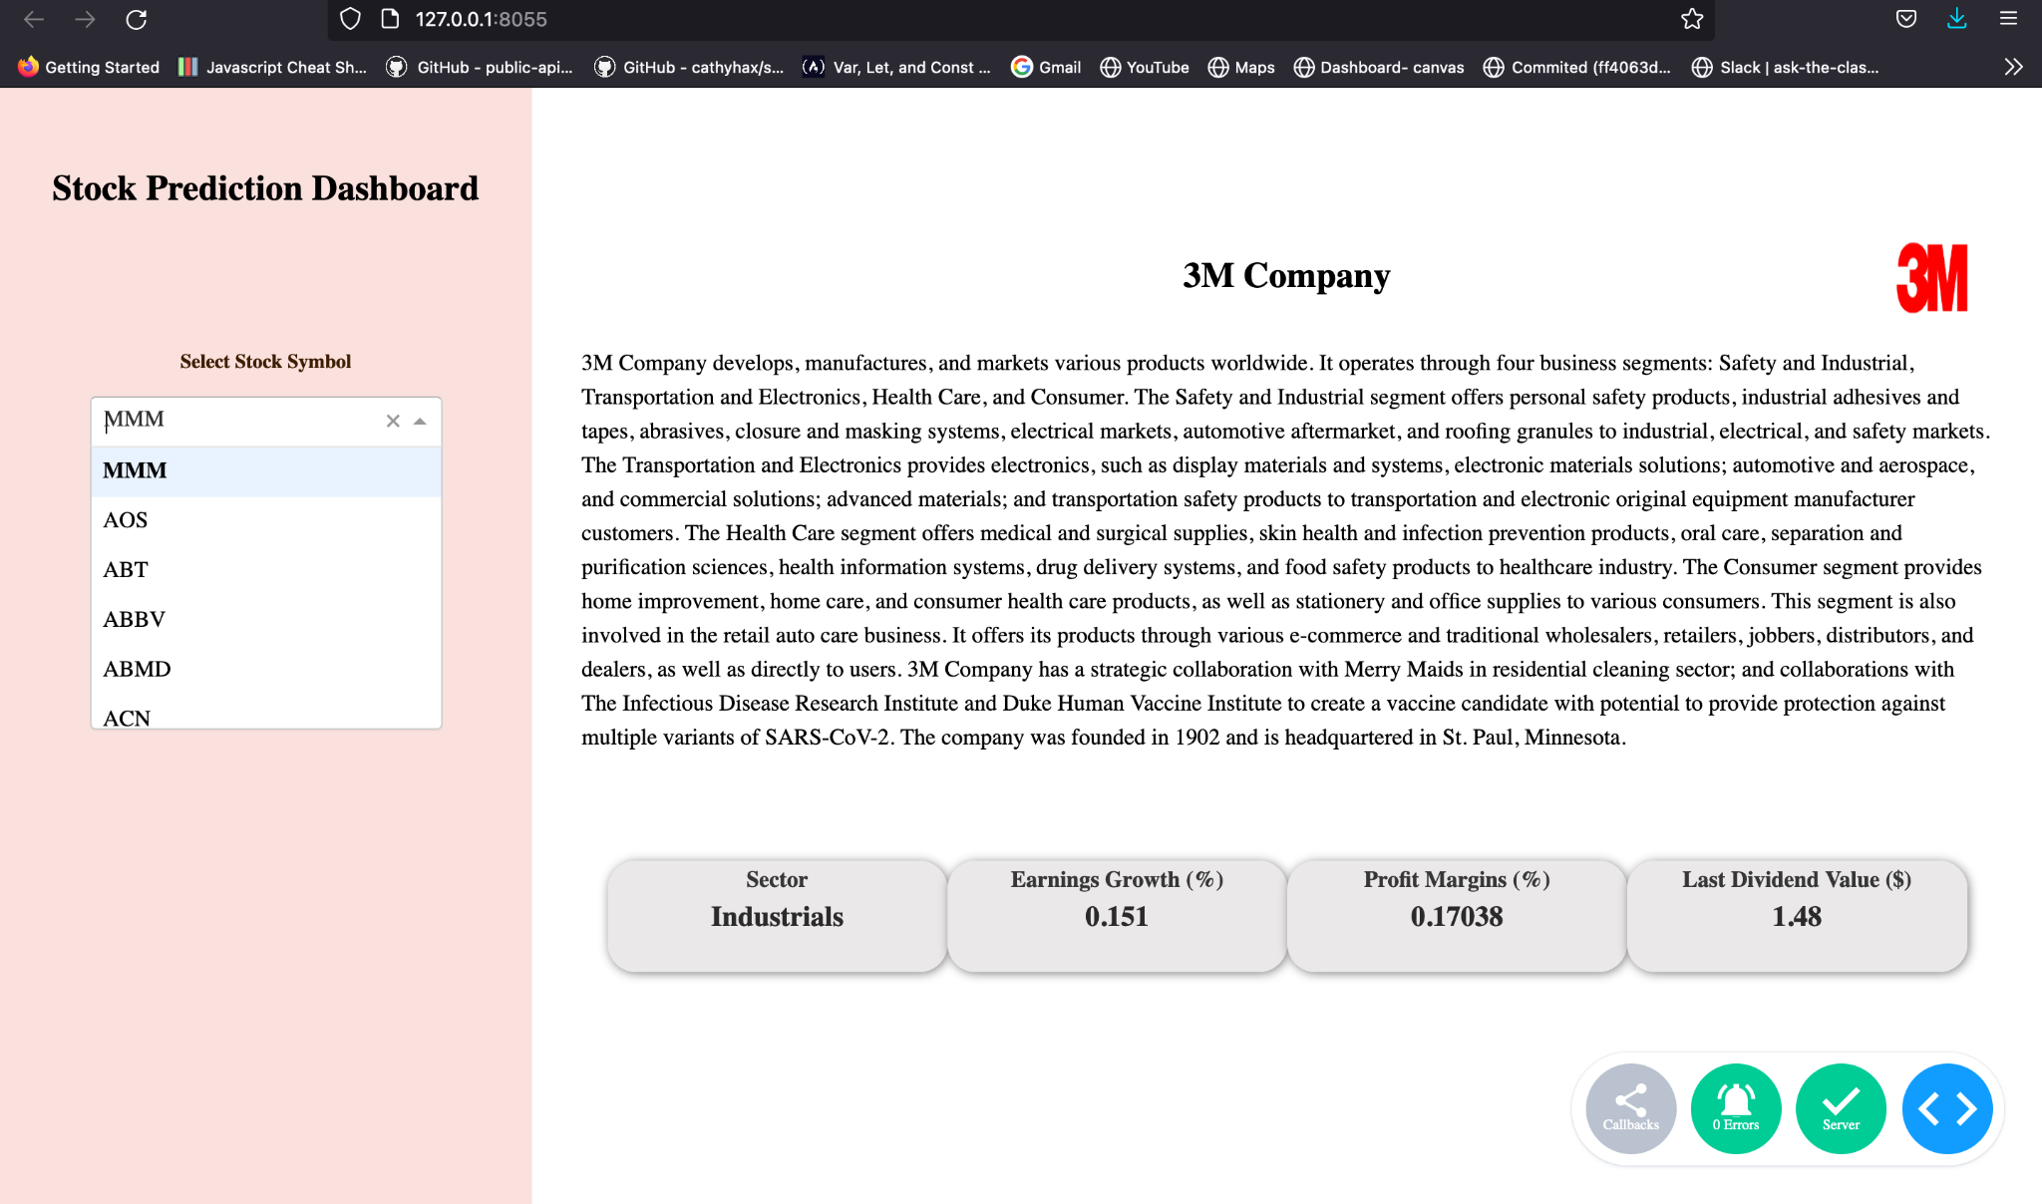
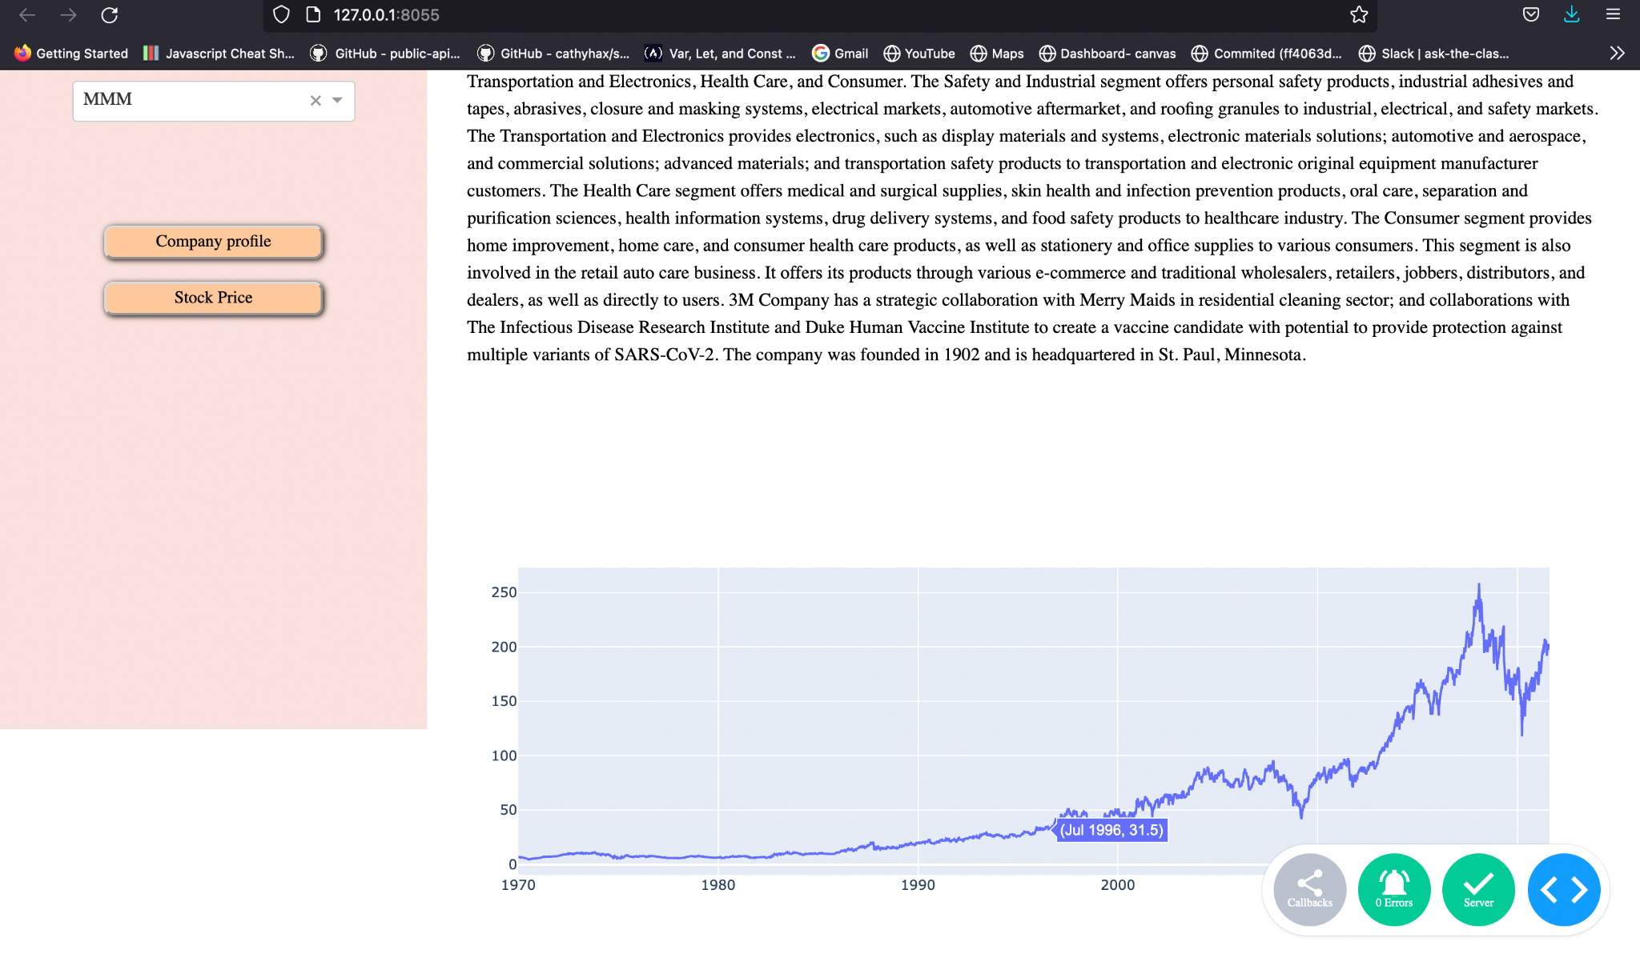
Fig 10 The images below is the interactive dashboard of how the company information, price and growth rate is mentioned and price at the end of day.

